Slide 1
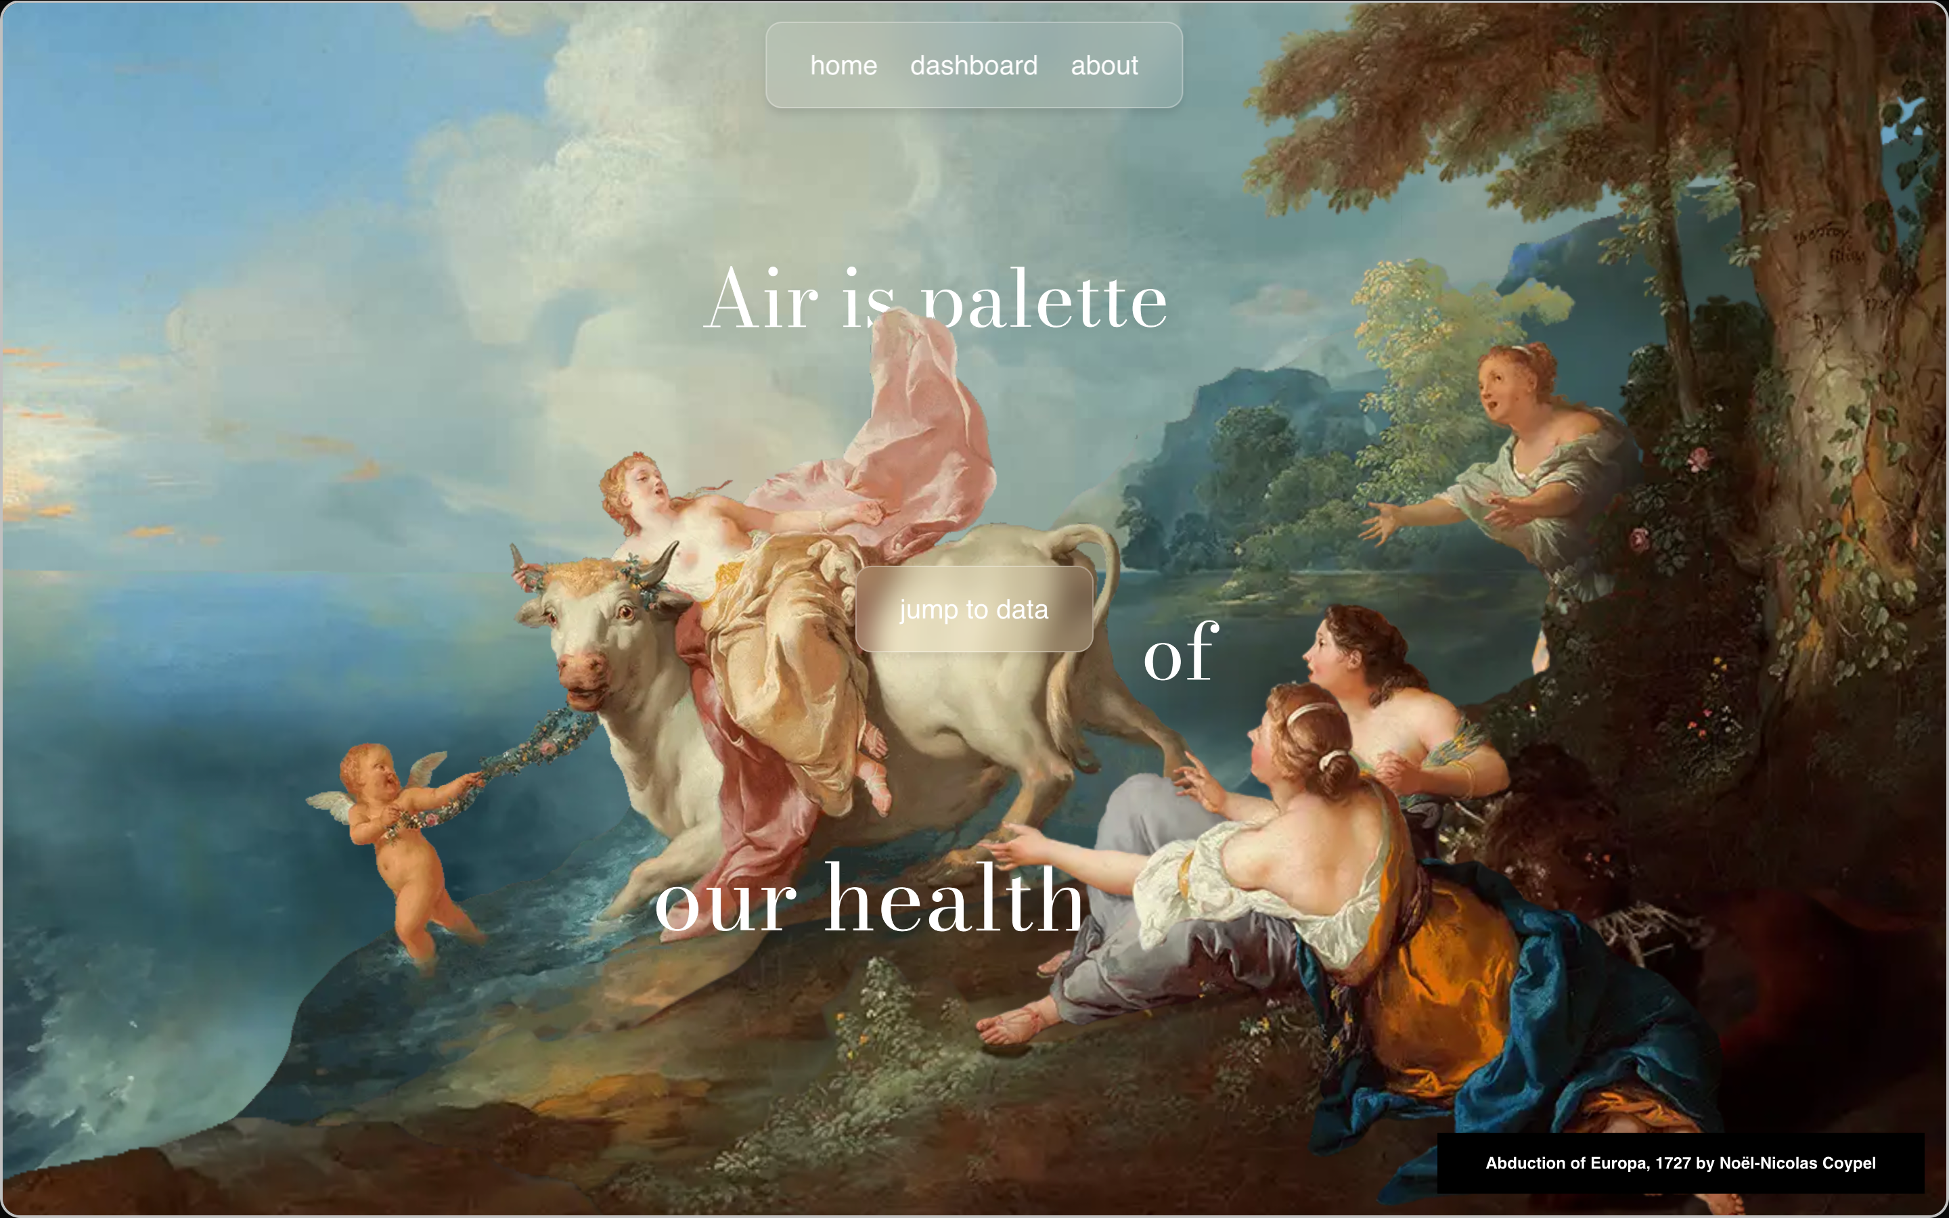
Home Page
outlook

Slide 2


Slide 3


Slide 4
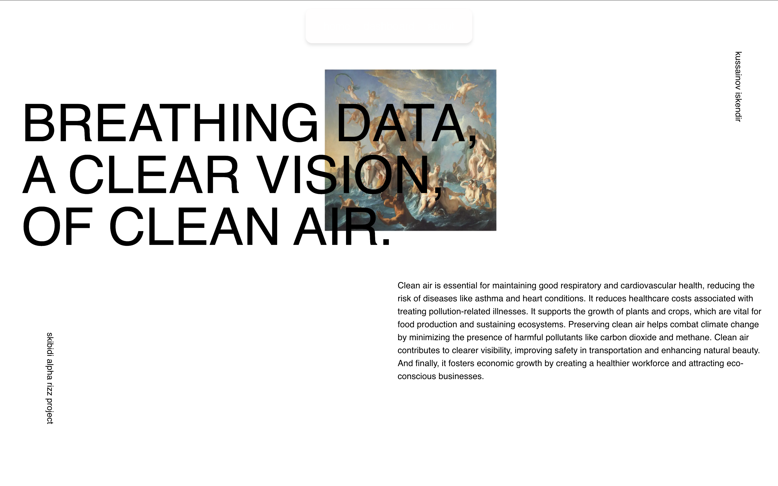
Home Page
outlook

Slide 5
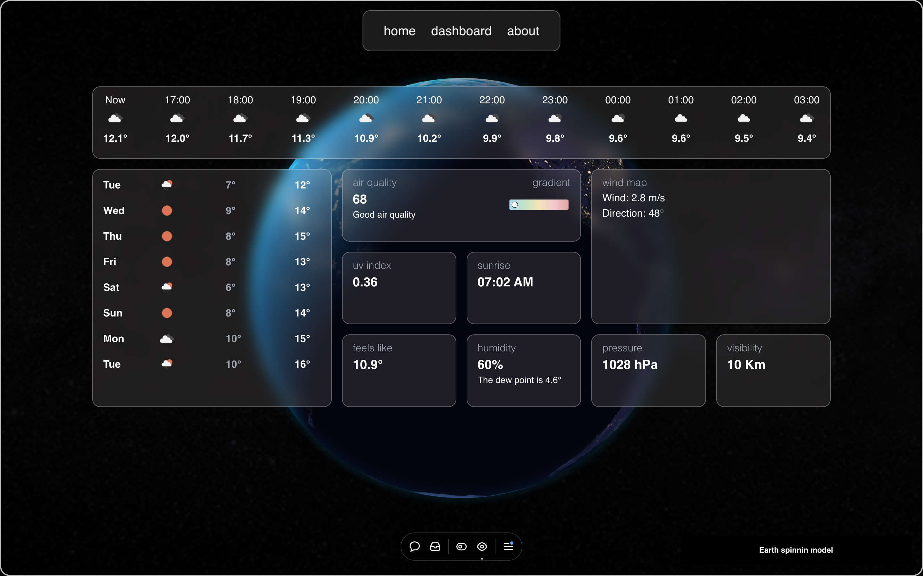
Dashboard Page
outlook

Slide 6
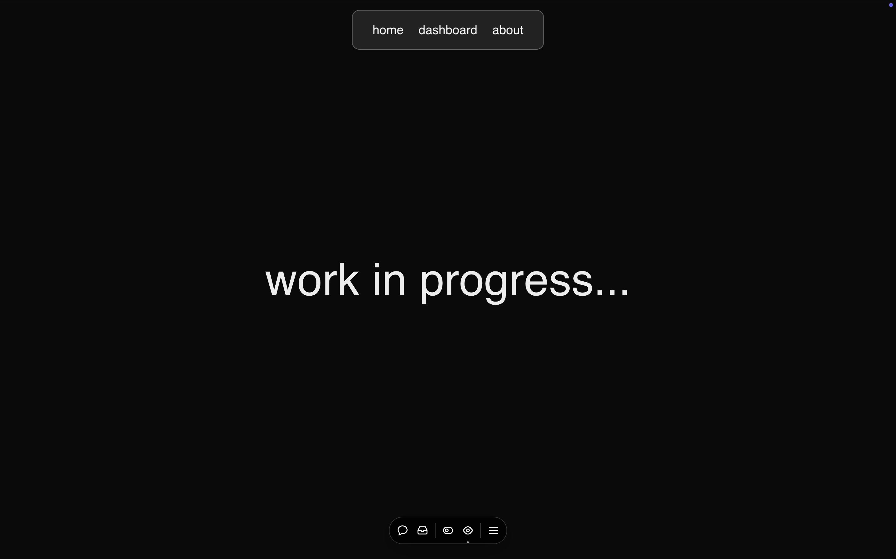
live demo: https://coupweather.vercel.app
things to work on

